Slide 1
Colorectal cancer-derived small extracellular vesicles induce epithelial to mesenchymal transition of normal hepatocytes: new insights on the hepatic pre-metastatic niche formation
Marzia PUCCI, Ornella URZI’ , Marta MOSCHETTI , Alice CONIGLIARO, Riccardo ALESSANDRO, Simona FONTANA
Dott.ssa Marzia Pucci
Department of Biomedicine, Neuroscience and Advanced Diagnostics (Bi.N.D)
University of Palermo
III international AICC Exosome Meeting "Cell to cell delivery in cancer and therapy: a matter of carriers and messages"

Slide 2
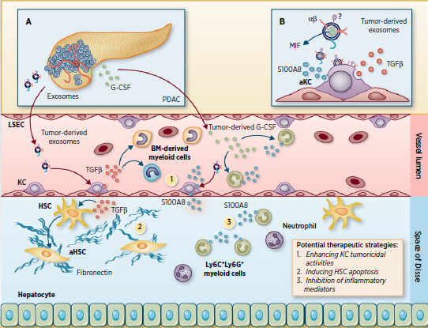
Small extracellular vesicles (sEVs) released from colon cancer cell lines (CRC) and liver parenchyma
COLORECTAL CARCINOMA AND LIVER METASTASIS
Data in the literature demonstrated the role of TDEs in the 'metastatic niche priming'
at the level of non-parenchymal cells
?
To date, the active role of hepatocytes in the formation of the pre-metastatic niche is not known

Slide 3
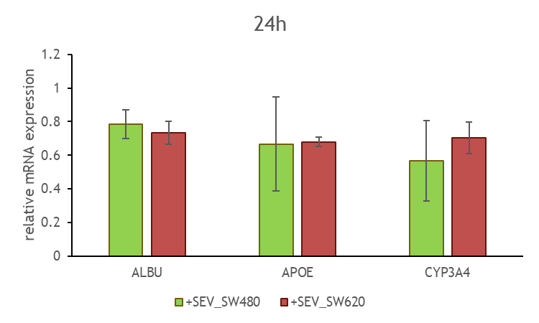
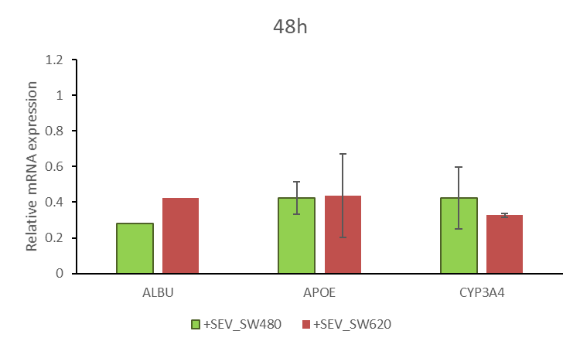
CRC-sEVs (20μg/ml) modulate the
functional properties of hepatocytes
RealTime PCR
Ctrl
***
*
*
Ctrl
**
ELISA ALBUMINA 24h
Ctrl
*
**
SW480
SW620
Cells
sEVs
Cells
sEVs
TGFβ1
Ctrl: not treated cells
*p≤0.05, **p≤0.01, ***p≤0.001

Slide 4
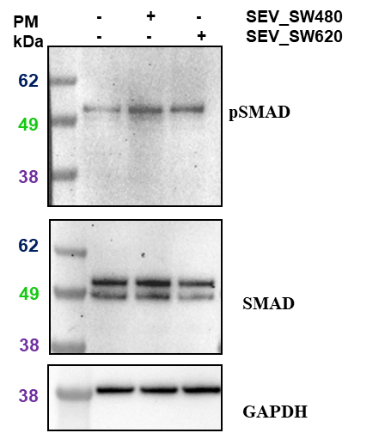
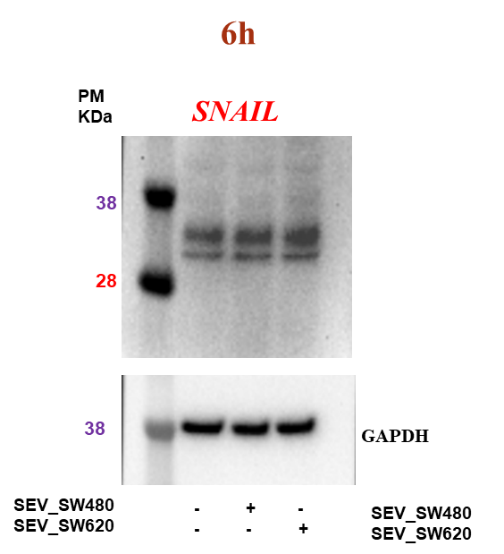
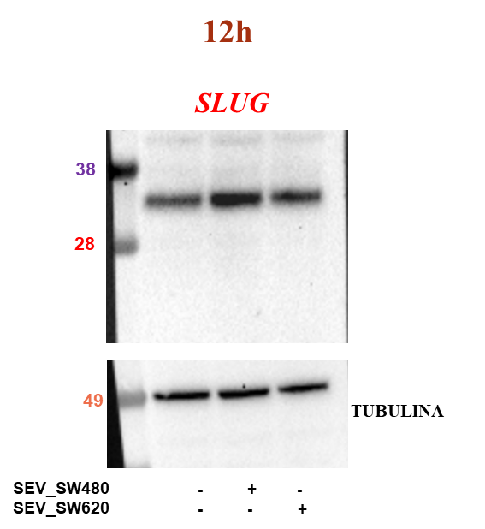
Treatment with CRC-sEVs induces epithelial to mesenchymal transition EMT
pSMAD/SMAD THLE2 cells (1h )

Slide 5
Treatment with CRC-sEVs induces epithelial to mesenchymal transition EMT
48h
CK8/18
E-cadherin
Vimentin
PM
kDa
PM
kDa
- + - SEV_SW480
- - + SEV_SW620
- + - SEV_SW480
- - + SEV_SW620
- + - SEV_SW480
- - + SEV_SW620
62
E-caderina
62
49
CK18
62
49
VIMENTINA
38
49
38
GAPDH
49
TUBULINA
49
TUBULINA
Epithelial markers
Mesenchimal marker

Slide 6
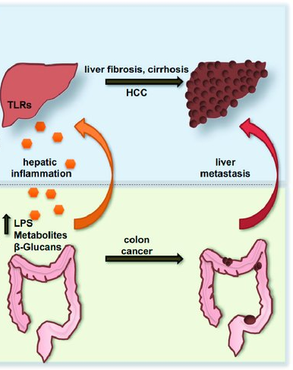
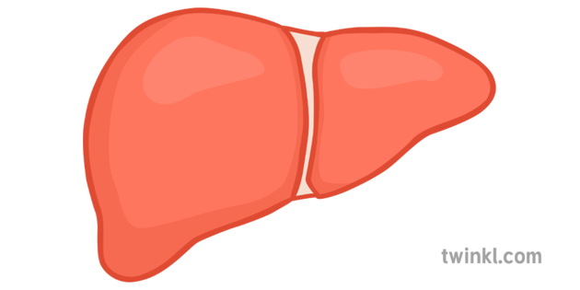
The fibrotic microenvironment
is driver of metastasis
Our data shows for the first time that CRC-sEVs modulate the properties of hepatocytes already in the pre-metastatic phase , inducing epithelial to mesenchymal transition (EMT) induced by sEVs-TGF-beta.
*
Hepatocytes could play an active role in the formation of the pre-metastatic niche participating in the formation of a fibrotic environment fundamental to support metastatic growth.
THE PROPOSED MODEL
CRC-SEVs
Pre-metastatic phase
Liver fibrotic
environement
EMT
E-cadherin
loss
Vimentin
Hepatocytes

